Slide 1

Introduction to real-world
Zeek deployment
Zeek Workshop Berkeley
Sept 11, 2026

Slide 2
Who Am I?
Fatema Bannat Wala
Security Engineer @ ESnet/LBNL
11+ yrs of hands-on network defense
Zeek LT Member / Zeek Training Subgroup Lead

Slide 3
Agenda (9am - 12pm)
What is a Zeek / Cluster?
Become familiar with Cluster Configs
Zeek’s Filesystem Layout
Running Zeek in a Cluster
<break 15 > 10:45 am - 11 am
Customizing Zeek
Zeek Package Manager (zkg)
<Lunch 1hr> 12:15 pm - 1:30 pm

Slide 4
Housekeeping
Zeek’s Official Documentation: https://docs.zeek.org
Join Zeek Slack channel #training
Slide deck for this training can be found here: https://github.com/zeek/zeek-training/tree/master/Intro-to-Zeek
  Highly recommend to have a copy of slide deck open in a browser tab, for easy copy paste of the commands in exercises.
Notes:
The links in the slide deck references to the Zeek Doc online, and the links are clickable.

Slide 5
Docker / Zeek Usage
Setup your Zeek Docker image
  Grab the latest Zeek LTS image from https://hub.docker.com/u/zeek
# docker pull zeek/zeek:lts
# docker run -it zeek/zeek:lts /bin/bash
  Inside the container, set up resources used during this training:
# git clone https://github.com/zeek/zeek-training
# ln -sfn /usr/local/zeek zeek
# ln -sfn /zeek-training/Intro-to-Zeek/training-res training-res
# cd zeek-training
# ./setup.sh all
  To run additional shells in the container:
# docker exec -it <container name> /bin/bash
Verify that Zeek runs correctly: # zeek --version
Notes:
If zeek is installed on your own server/laptop, you can pull down the training-repo and use the export command.

Slide 6



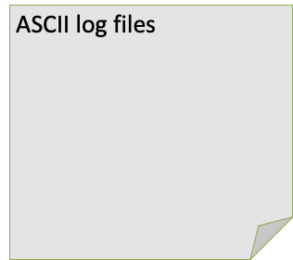

What is Zeek?
Zeek NSM
Sniffs traffic
Generates logs
http.log
ssl.log
ssh.log
smtp.log
weird.log
notice.log

Slide 7
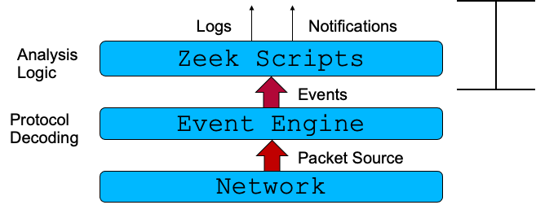

Zeek Packet Pipeline

Slide 8
What is a Zeek Cluster?

Slide 9
What / Why
A Zeek Cluster is a set of system processes, all running Zeek, with a set of scripts that adjust their purpose
  As opposed to running a single Zeek process, reading from a pcap, for instance
  Can run on one or more host environments — machines, VMs, containers, etc
To scale Zeek to keep up with more traffic, one adds processes (“nodes”) to the cluster
Supporting tools handle tasks like monitoring processes and log rotation
If you need 24x7 network monitoring, clustering is your answer

Slide 10
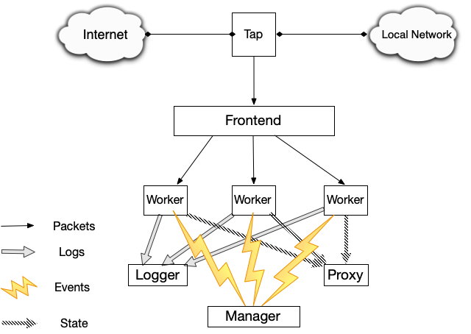
Source : Zeek Project. Creative Commons

Slide 11
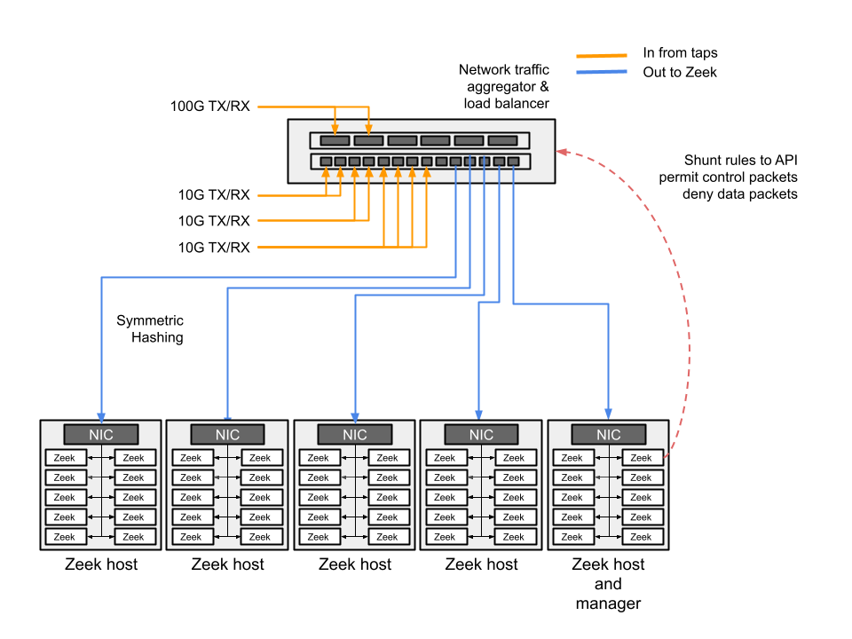
Source : Zeek Project. Creative Commons

Slide 12
Sniffing Packets
SPAN/MIRROR ports
  Configured on the router/switch
  Pros :
    Flexible (could mirror only certain network segments)
    Might keep your network people happy (they can control the setup)
  Cons :
    Consumes router resources (CPU/physical ports)
    Vulnerable/Visible to attackers (modifying/viewing configs)
    Mistakes in managing network gear can impact flows

Slide 13
Sniffing Packets
Taps
  No moving parts, no config, invisible to attackers
  Each link consumes two ports
  Passive
    Split light at fixed ratios (50/50 or 70/30 are common)
    Light budget requires coordination with networking team based on distances
    Reliable for Fiber optics
  Active
    Electrically powered device
    Useful for converting signal types (such as 10 Gb SR to 10 Gb LR)
    Useful for copper infrastructure

Slide 14
Tap Aggregation (Packet Brokers)
Merges multiple tap sources
Can output to groups of tools
Arista / Gigamon / Ixia, for example
Advanced features
  Packet deduplication
  Packet Slicing
  Timestamping
  Tagging

Slide 15
Worker Load Balancing
Open Source
  AF_PACKET
    Built into Linux kernel
    Out of the box support in Zeek (AF_packet Plugin)
    Can be challenging to setup and tune
    Interrupt-based
  DPDK
    Zeek package handles configuration
    Also check out Vlad’s talk at ZeekWeek
    Comes with ~ 50 NIC drivers
    Polling-based
    Does not currently support bonded interfaces

Slide 16
Worker Load Balancing
Commercial Solutions - NICs
  Examples : Endace / Napatech / Myricom / Intel (ex. X710)
  Expensive solution for very high performance
  I’m most familiar with Myricom
    Provides in-memory ring buffers with symmetric hashing
    Very easy to support
    Proprietary driver, updates can lag behind kernel versions

Slide 17
Source : Zeek Project. Creative Commons

Slide 18
Cluster Components
Manager
Worker
Proxy
Logger

Slide 19
Cluster Components
Manager
  Every cluster has exactly one
  Writing logs from workers (when not using separate logger nodes)
  Useful for smaller volumes or limited hardware
  Can also run scripts when you want to conduct analysis across multiple workers
  Natural point in the cluster for centralized state

Slide 20
Cluster Components
Manager
Worker
  Analyze network packets to create (most) events & logs
  Run scripts to alert on interesting traffic

Slide 21
Cluster Components
Manager
Worker
Proxy
  State sharing among cluster workers
  Start with one, then add more if load is an issue

Slide 22
Cluster Components
Manager
Worker
Proxy
Logger
  Write logs via configurable writer plugins for files, Kafka, Elastic, etc
  Easy support to load balancing among multiple logger nodes
    Log rates vary depending on traffic and writer technology
    Very roughly, up to 100K events/sec per logger should work
  Good way to scale log I/O in high volume environments
  Defaults to TSV-format file logging, but easy to switch to JSON or alternatives

Slide 23
Cluster Architecture
Single Physical Box
  Inexpensive, easy management
  Useful for a single feed
For example: A 2U box with Intel(R) Xeon(R) Silver 4209T CPU @ 2.20GHz with 16 physical cores, and 376G memory for two 10G links monitoring

Slide 24
Cluster Architecture
Hardware Cluster
  Separate boxes for workers
    1U boxes
    Fast CPU, Lots of RAM, small disk (low I/O requirements)
    Allows horizontal scaling
    Not good candidates for VM environments
  Manager/Proxy/Logger on a single host
    Moderate CPU/RAM
    Fast Disk, ideal for logger node(s)
    Good components to consider running in a VM environment

Slide 25
Performance
How big?
  That depends. A lot.
  ~ 6 GB per worker process
  Faster CPUs are always better
LBL 100G Paper
  Good architecture overviews
SEPTun-Mark-II
  Originally written for Suricata, but all concepts on packet queues, NUMA, OS tuning, etc apply
CPU Pinning
  Avoid using hyperthreaded cores for workers
Fine tuning via ethtool - tro/tso/rx/tx/ etc..
Metrics/Monitoring
  Zeek 7+ features a new telemetry framework with built-in Prometheus scraping support
  Alternatively, consider the Zeek Exporter from ESNET
  Collectd

Slide 26
Shunting
Reduce load by blocking elephant flows
Streams/large file transfers over TLS, for example
Ideally, you block the data packets, but let TCP control packets through
  Zeek can tell you conn size, packet count, duration
Dumbno (for Arista)

Slide 27
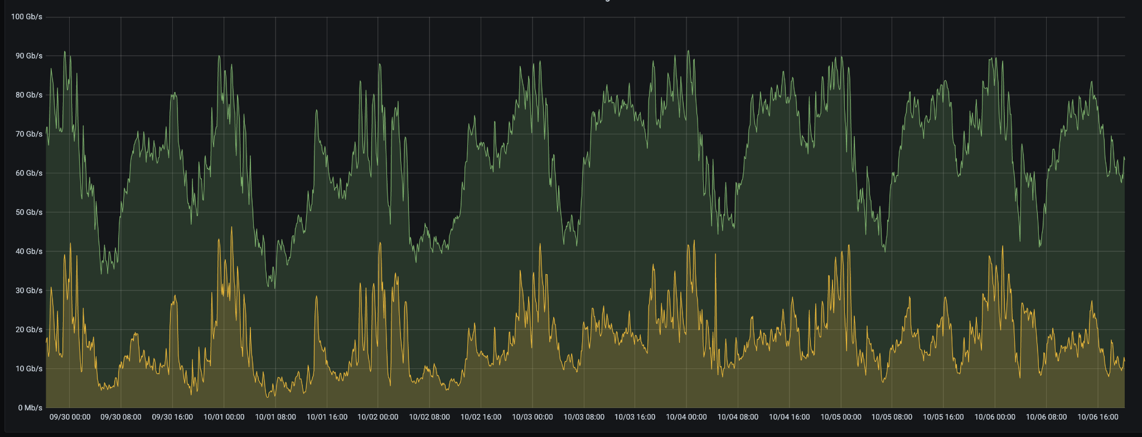
Shunting

Slide 28
Real-world Deployments

Slide 29
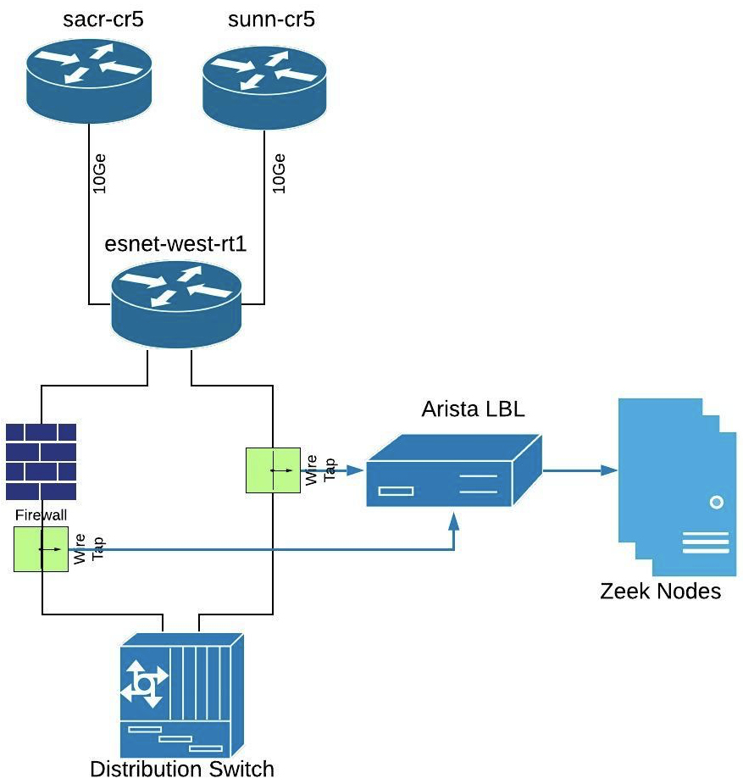
N/W Architecture for Zeek deployment # 1

Slide 30
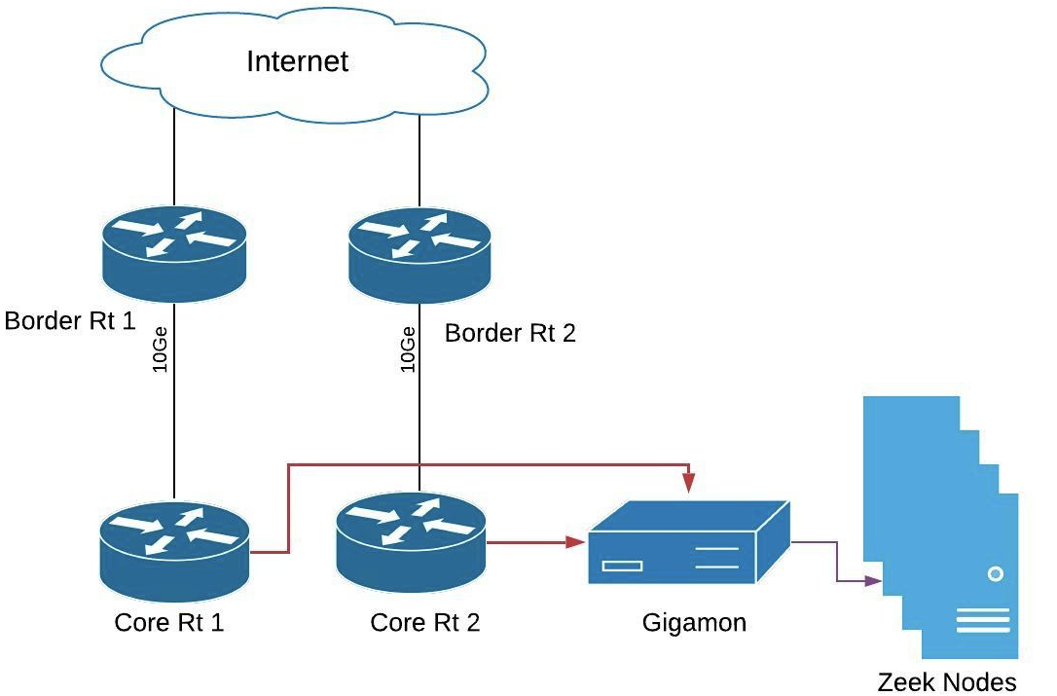
N/W Architecture for Zeek deployment #2

Slide 31
Zeek’s Filesystem Layout

Slide 32
Filesystem Layout
Not an exhaustive tour!
Default top level path: /opt/zeek/ or /usr/local/zeek
  bin/
  etc/
  include/ - ignoring today
  lib/ lib64/ var/ - ignoring today
  logs/
  share/
  spool/

Slide 33
Filesystem Layout
bin/
  zeek-cut
    Extract columns from Zeek’s TSV logs (non-JSON)
    Convert Unix epoch
  zeek
    Zeek executable with various options to run
  zkg
    Zeek package manager executable
  zeekctl
    Cluster management tool

Slide 34
Filesystem Layout
etc/
  network.cfg
    Define your local networks
  node.cfg
    Configure a cluster
    Extra features (lb_procs, pin_cpu, lb_method)
  zeekctl.cfg
    Configure cluster management tool
    Set shorter rotation time

Slide 35
Filesystem Layout
logs/
  current
    Default Log Path (cluster-mode)
  current directory
    Default Log Path (CLI mode, logs overwritten
each run)
  YYYY-MM-DD
    Logs archived to this dir,rotated hourly by default

Slide 36
Filesystem Layout
spool/
  state.db
    Cluster worker state (zeekctl)
  zeekctl-config.sh
    Cluster management variables (zeekctl)
  worker-<n>
    .pid
    .cmdline
    .env_vars
  logger
    logs (“current” is a symlink)
  extract_files/<node>/
    Extracted (“carved”) files, when configured

Slide 37
Filesystem Layout
share/
  zeek/base/
    Base scripts
  zeek/policy/
    Additional scripts
  zeek/site/
    Site-specific scripts
    Packages installed via zkg, our package manager
  hilti/ and spicy/
    Analyzers written in Spicy, our parser generator
  zeekctl/
    Helper scripts for cluster management (e.g. log post-processing)

Slide 38
Exercise #1: fire up a cluster (10 mins)
Edit node.cfg - comment out the standalone section, and uncomment the logger, proxy, manager and worker-1 sections.
$ vi /zeek/etc/node.cfg
[worker-1]
type=worker
host=localhost
interface=af_packet::eth0
lb_method=custom
lb_procs=2
pin_cpus=0,1
Set shorter rotation time
$ vi /zeek/etc/zeekctl.cfg
LogRotationInterval = 300 //(5mins)
Set your local network
$ vi /zeek/etc/network.cfg

Slide 39
turn off the checksum with Zeek redef
$ vi /zeek/share/zeek/site/local.zeek
redef ignore_checksums = T;
Then run:
$ zeekctl deploy
Make sure cluster is running:
$ zeekctl status
Create some traffic for the cluster to sniff
$ wget google.com
$ ls /zeek/logs/current/
Send few pcaps to the sniffing interface:
$ tcpreplay -i eth0 --mbps=500 /training-res/traces/*.pcap
$ ls /zeek/logs/current/
Stop the cluster
$ zeekctl stop

Slide 40
MORNING BREAK [15 mins]
[10:45-11am]

Slide 41
Customizing Zeek
/zeek/share/zeek/site/local.zeek
  local customizations
    Can be done inline or separate script
  enable or disable scripts
  change variables

Slide 42
Customizing Zeek
Loading additional scripts:
$ vi /zeek/share/zeek/site/local.zeek
Changes to local.zeek require restart in cluster mode!
@load policy/protocols/http/header-names
$ zeek --help
Note the $ZEEKPATH output, which defines the script file search path:
. (current directory)
/usr/local/zeek/share/zeek
/usr/local/zeek/share/zeek/policy
/usr/local/zeek/share/zeek/site
Notes:
Packet-fragments won’t work with @load...

Slide 43
Customizing Zeek
Zeek scripts can have modules, with an export section
  An interface to a particular component of Zeek, basically
  Usually features “redefinable” variables
    Redefinitions are tweaks to constants, types, etc at Zeek startup
    Adjustments then become constants
  In each framework, main.zeek is best place to start looking
$ less /zeek/share/zeek/base/protocols/http/main.zeek
export {
# This setting changes if passwords used in
# Basic-Auth are captured or not.
option default_capture_password = F;
}

Slide 44
Customizing Zeek
A number:
redef SSH::password_guesses_limit = 15;
A table:
redef SSH::ignore_guessers += {
[192.168.1.2/32] = 192.168.1.20/32 };
A boolean:
redef HTTP::log_server_header_names = T;

Slide 45
Config framework
Provides Zeek configurability via config files, with run-time updates
For tunables defined with the option keyword
Supports callbacks to react to changes
Asynchronous nature can be tricky, particularly at startup
Make sure to read the documentation

Slide 46
Config framework example
module Test;
export {
option enable_feature = F;
}
Options are a kind of redefinable value, so this still works:
@redef Test::enable_feature = T;
Now define config option file for Zeek to watch:
redef Config::config_files += { “/zeek/share/zeek/site/config.dat” };
Put content in the file with lines of the form “[option name][tab/space][new value]”
Test::enable_feature T

Slide 47
Exercise #2: Customizing Zeek (10 min)
$ vi /zeek/share/zeek/site/local.zeek
Log server header names in HTTP (in local.zeek)
@load policy/protocols/http/header-names
Start with: /training/http-auth.pcap
$ tcpreplay -i eth0 --mbps=500 /training-res/traces/http-basic-auth.pcap
Log http usernames and passwords:
redef HTTP::default_capture_password=T;
Replay traffic:
$ tcpreplay -i eth0 --mbps=500 /training-res/traces/http-auth.pcap
Note: don’t forget to restart (deploy) after making changes in local.zeek

Slide 48
Package Manager (zkg)
Package Manager
  zkg
  https://packages.zeek.org
Can add new scripts or analyzers
  Analyzer examples :
    QUIC
    PerfSonar
  Scripts :
    BZAR
    DHCP OUI data

Slide 49
Let’s Use zkg!
List all zeek packages and install a few
# zkg refresh
# zkg list all
# zkg install cve-2020-0601
Check if they got installed
# zkg list installed
# ls /zeek/share/zeek/site
Let’s load the packages
uncomment @load packages in site/local.zeek

Slide 50
Let’s Use zkg!
zkg load/unload and info
# zkg unload cve-2020-0601
# zkg info cve-2020-0601
Remove and uninstall all the packages
# zkg purge
# zkg list installed
Other useful zkg commands
remove, pin, unpin, upgrade, refresh

Slide 51
Exercise #3: Zkg
10 minutes..
Running Zeek with zkg installed packages, specifically with JA3.
# zkg install ja3
# zeekctl deploy
# tcpreplay -i eth0 --mbps=500 /training-res/traces/extract.pcap
# less /zeek/logs/current/ssl.log
# cat ssl.log | zeek-cut -d ja3 ja3s

Slide 52
Exercise #4: Zkg
Extract a file from a file transfer connection using file-extract zkg package
# zkg install file-extraction
Add all file types extraction to the config of the package:
# vi /zeek/share/zeek/site/packages/file-extraction/config.zeek
redef path = "/extracted_files/";
@load ./plugins/extract-all-files.zeek
# mkdir /extracted_files
# zeekctl deploy
# tcpreplay -i eth0 --mbps=500 /training-res/traces/extract.pcap
# ls /extracted_files/
# less files.log

Slide 53
Lunch Break
[12:15-1:30 pm]

